Slide 1

GDPredict: A Machine Learning Approach Towards GDP per Capita Prediction
Sanket Kashyap, 23BBS0023
Ujjwal Hirwani, 23BBS0036

Slide 2
Objectives
GDP per Capita Prediction
Modeling key Economic Indicators
Enhancing Policies and Decision Making

Slide 3
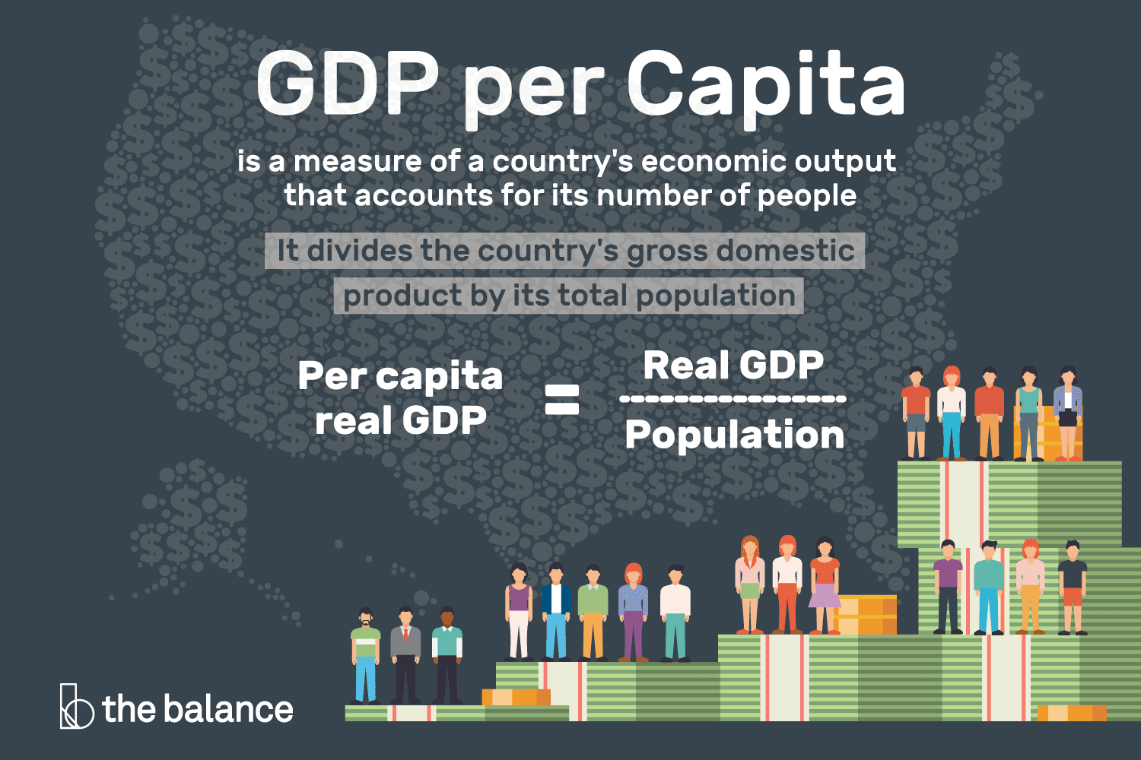
What is gdp per capita?
Living Standards – Indicates the average economic well-being of a population.
Economic Comparison – Allows fair comparison of prosperity across countries.
Policy Planning – Guides government in making development and welfare policies.
Investment Decisions – Helps investors assess market potential and stability.
Growth Tracking – Monitors economic progress over time, adjusted for population.

Slide 4
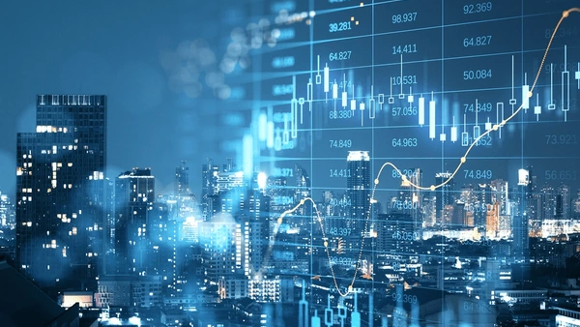
Proposed Methodology
Economic Indicator Identification
Data Sourcing
Data Cleaning & Feature Scaling
Exploratory Data Analysis
Regression Model Implementation
Model Accuracy Assessment
Result Interpretation

Slide 5
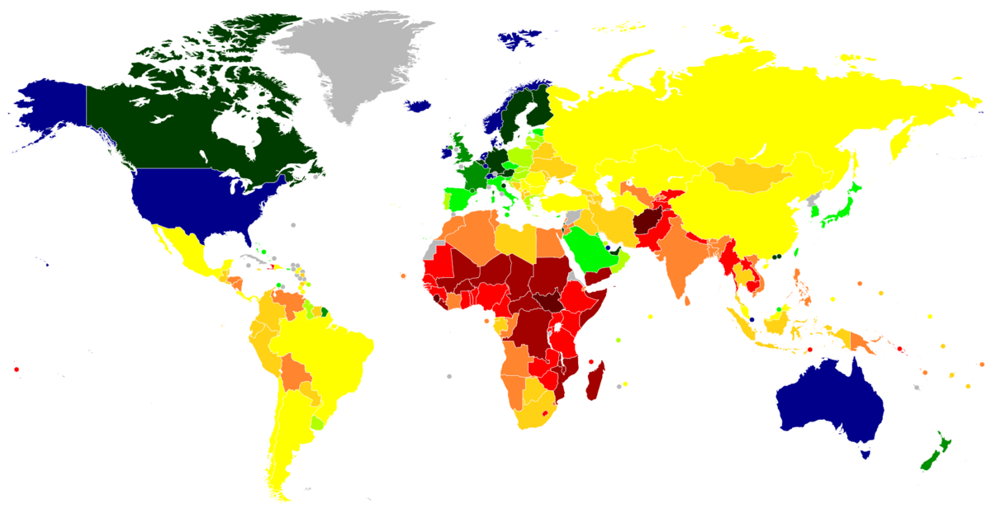
Problem Understanding
The project applies machine learning techniques to forecast GDP per capita, a key indicator of prosperity and living standards.
The model leverages historical GDP data along with economic, social, and demographic variables, using data preprocessing, feature engineering, and regression-based prediction to capture hidden patterns.
Scenario 1: Policy reforms boosting innovation are modeled using past regional data to forecast GDP growth.
Scenario 2: Global downturns (e.g., pandemics) are represented in training data, allowing the model to simulate declines in GDP.
Scenario 3: Technological progress, such as automation, is integrated as features to forecast productivity-driven growth.

Slide 6

Problem Understanding
Social Impact
Policy Planning & Resource Allocation: Accurate forecasts guide fair policies and distribution.
Early Warning: Predictive models act as signals for potential crises.Business
ImpactInvestment & Strategy: Companies and investors use GDP forecasts to reduce risks and adapt strategies.
Sectoral Insights: Feature importance analysis highlights key growth drivers like agriculture, industry, or services

Slide 7

Dataset selection
Selected Dataset: Countries of the World, from Kaggle.
Dataset link: https://www.kaggle.com/datasets/fernandol/countries-of-the-world.
Why We Chose This Dataset?
The dataset was selected because it provides a comprehensive set of socio-economic and demographic indicators that directly influence GDP per capita. It contains features such as population, literacy rate, birth and death rates, net migration, agriculture, industry, and services, which are widely recognized as key drivers of economic growth.
Importantly, the data source is highly reliable, as it is derived from the CIA World Factbook, a reputable and widely used reference published by the US government. According to its guidelines, the dataset is in the public domain and can be freely used by anyone. This ensures both accessibility and credibility, making it suitable for academic research and machine learning applications.

Slide 8
Dataset selection
From a technical perspective, the dataset is well-suited for machine learning because:
It includes both numerical and categorical variables, allowing exploration of diverse feature interactions.
It offers sufficient variability across countries and regions, ensuring the model can learn meaningful patterns.
Missing values and outliers are manageable, making it a good candidate for preprocessing and feature engineering.
By capturing multiple dimensions of the economy and being sourced from a trusted authority, this dataset enables the development of a predictive model that balances accuracy, interpretability, and real-world relevance in forecasting GDP per capita.

Slide 9

Data preprocessing
Drop Unwanted Features
Checking for Null Values
Handling Missing Value
Handling Outliers
Handling Categorical Data
Splitting Data Into Train and Test
Feature Scaling

Slide 10
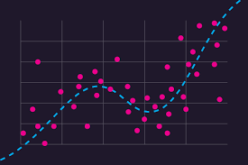
What is Regression?
Definition: Regression is a supervised learning technique used to predict a continuous numeric value by modeling relationships between a dependent variable and one or more independent variables.
Purpose in Project: To estimate GDP per capita using economic indicators like inflation rate, unemployment rate, trade balance, and education index.
Why Use Regression?
Captures trends in historical data.
Quantifies impact of each economic factor.
Enables accurate economic forecasting.
Common Models: Linear Regression, Random Forest Regressor, XGBoost Regressor, Support Vector Regression.
Output: A predicted GDP per capita value for given input indicators.

Slide 11
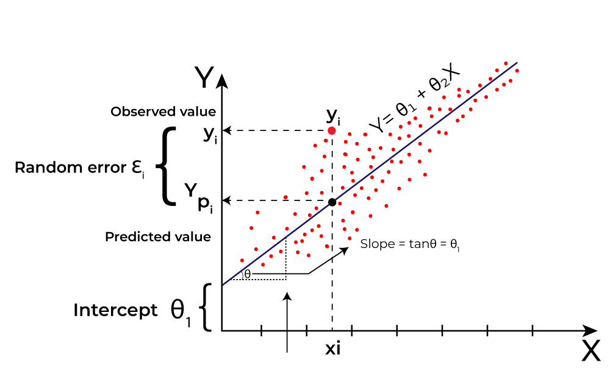
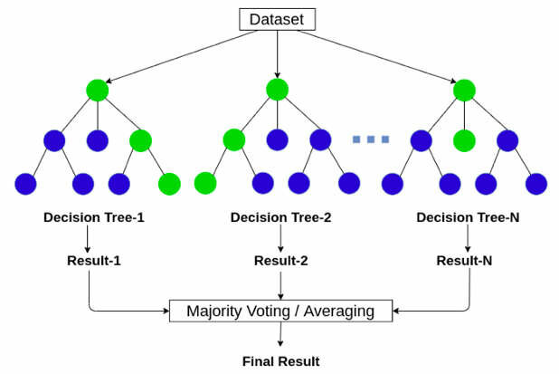
Initial Implementation
Model Selection and Comparison
To predict GDP per capita, we applied and compared three different regression models: Linear Regression, Random Forest Regressor, and Support Vector Regressor (SVR). Each model was chosen to capture different aspects of the relationship between socio-economic indicators and GDP.
Linear Regression Model
Linear Regression was selected as a baseline model because it assumes a direct linear relationship between features and the target variable.
The model achieved a score of 0.7826 with an RMSE of 4649.54, indicating that it was able to capture general trends in the data but struggled with more complex, nonlinear patterns.
Random Forest Regressor Model
Random Forest, an ensemble learning method, was used to handle nonlinear relationships and feature interactions effectively.
It achieved the best performance among the three models, with a score of 0.9164 and an RMSE of 2883.45, showing that it could generalize well and reduce prediction error significantly compared to Linear Regression.

Slide 12
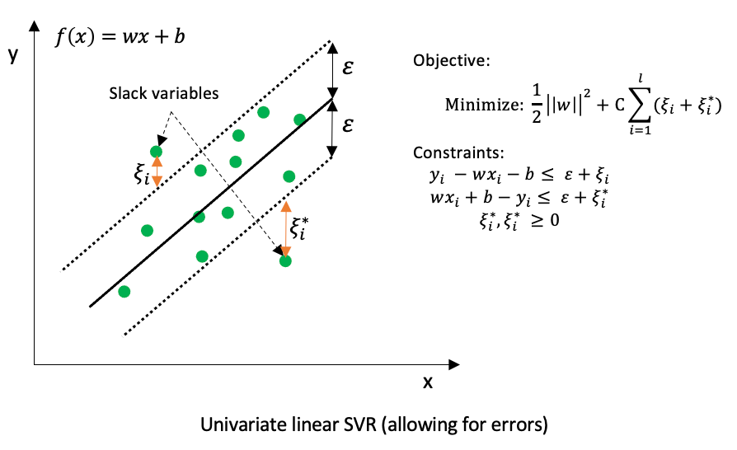
Initial Implementation
Support Vector Regressor (SVR) Model
SVR was included to test its capability in handling high-dimensional data and capturing nonlinear trends using kernel functions.
However, in this case, it performed poorly, with a negative score of -0.2612 and a very high RMSE of 11199.06, suggesting that the model was not suitable for this dataset, possibly due to scaling issues or the presence of multiple features with wide value ranges.
Conclusion from Comparison
The comparative analysis clearly demonstrates that the Random Forest Regressor outperformed the other models in terms of both accuracy and error minimization. While Linear Regression provided a reasonable baseline, SVR underperformed significantly. This highlights the importance of selecting models that can handle the complexity and variability of socio-economic datasets.

Slide 13
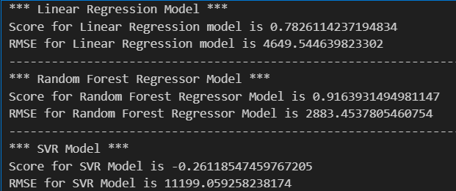
Midway Results/Validation
Models Evaluated:
Linear Regression
R² Score: 0.78
RMSE: 4649.54
Random Forest Regressor
R² Score: 0.92
RMSE: 2883.45
Support Vector Regressor (SVR)
R² Score: -0.26
RMSE: 11199.06

Slide 14
Midway Results/Validation
Key Observations:
Random Forest Regressor shows the best performance with the highest R² and lowest RMSE.
Linear Regression performs moderately well.
SVR model performs poorly, with negative R² and very high RMSE.
Conclusion (so far): Random Forest Regressor is the most promising model for further tuning and validation.

Slide 15

Thank You

